Slide 1
Final Presentation
COVID 19

Slide 2
Dataset
News Data: Sourced from BigQuery ‘The GDELT Project’ (source: https://blog.gdeltproject.org/now-live-updating-expanded-a-new-dataset-for-exploring-the-coronavirus-narrative-in-global-online-news/)
NYC News Data:
Pulled for the period: Jan 1, 2020 to May 14,2020 (2,335,195 rows)
Random Sampling for Topic Modelling (300,000 rows)
Data was split into 2-week periods to get a time-wise importance of topics in these articles

Slide 3
Methodology
Data fields used: Text of the article (Contextual Text), Title of article (Title) and Date of publishing (Date)
Preprocessed data:
Split data into 9 parts for each 2-week period (from January to Jan)
Text Preprocessing: Removal of numbers, removal of stop words, remove punctuations, Lemmatization
Created Document Term Matrix
Topic Modelling for each month using LDA
The topics were categorized into
Health: Symptoms (words like fever, flu, death etc.)
Health: Prevention (words like quarantine, mask, social-distance etc.)
Economy: both market-related words and employment related words (ex: company names, stock-market, price, index etc.)
Travel (words like airport, ship, flight etc.)
Topic Weightages were calculated using Topic probabilities given the documents. (For this, the themes of each of these topics were manually defined on the basis of the words present in the topic)

Slide 4
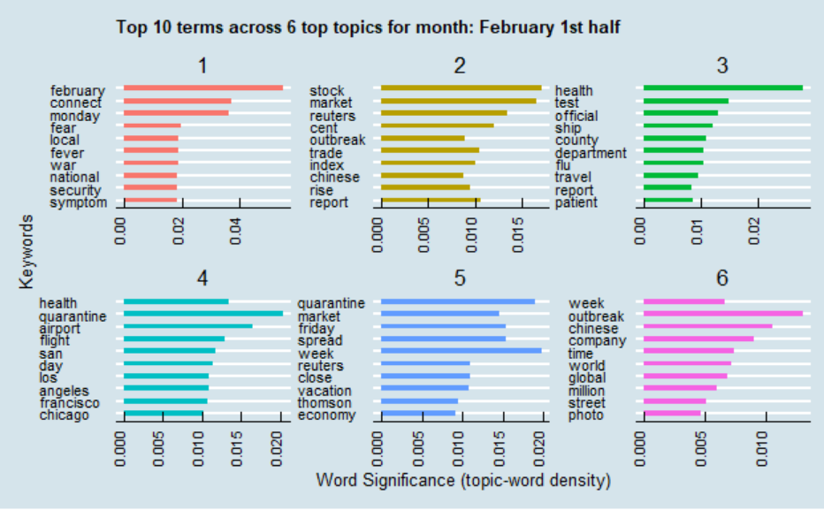
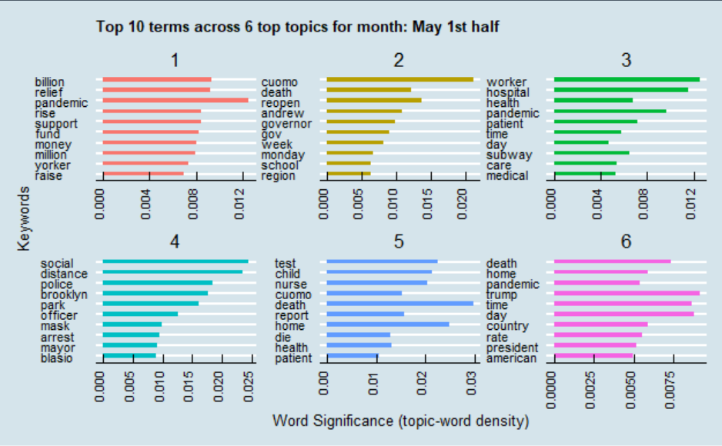
Topic Modelling was conducted to get significant themes from the news articles in NYC
The illustrative example for topics derived from articles published in the first half of February (first 2 weeks) are:
Health: symptoms
Travel limitations and rules
Economy: Stock Prices and market performance
Illustrative topics in May (1st half):
Health: preventive measures (social distance, quarantining)
Health: symptoms

Slide 5
Timeline Plots for NYC
Timeline plots from News data
Timeline plots from Google Trends data

Slide 6
Comparison of NYC and SF
Timeline plots from NYC News
Timeline plots from SF News
Period | Most pressing issue in NYC | Most pressing issue in SF
Jan 1st half | Health-Symptoms | Economy
Jan 2nd half | Health-Symptoms | Health-Symptoms
Feb 1st half | Economy | Health-Symptoms
Feb 2nd half | Health-Precautions | Health-Precautions
March 1st half | Health-Symptoms | Health-Symptoms
March 2nd half | Economy | Health-Symptoms
April 1st half | Health-symptoms | Health-Precautions
April 2nd half | Health-Precautions | Economy
May 1st half | Health-Symptoms | Health-Precautions
Include the table.. As this will make a comparison of how the two cities
differed in their most important issue at a given time and thus policy makers
should focus on different things based on the geography and demographics

Slide 7
Conclusion
Most of the priorities of the public can be broadly classified as issues on:
Health-symptoms
Health-precautions and preventive measures
Economy and employment
Travel plans
The priorities of the public in a megacity evolves through the different stages of a pandemic
This reflects on the psyche of the public and the most pressing issue which needs to be addressed at a given point of time
Priorities of the public differ according to the geography and the demographics as the priorities of the public in NYC and SF evolved differently through the course of the pandemic.

Slide 8
Next Steps
Integrate covid testing cases data within the Topic Models to derive topic weightages as a function of the pandemic stages
Create a robust callable modelling framework for all cities
Break NYC topics according to demographics to reflect on the different priorities of the diverse population in a megacity

